Slide 1

Big Data Storage and Processing MSc in Data Analytics CCT College Dublin
Apache Cassandra
Week 7
Lecturer: Dr. Muhammad Iqbal*
Email: miqbal@cct.ie
©CCT College Dublin 2022

Slide 2
Agenda
Introduction to Cassandra
CAP Theorem
Characteristics of Cassandra: Distributed and Decentralized, Elastic Scalability, High Availability and Fault Tolerance, Tuneable Consistency, Row-Oriented and High Performance
Is Cassandra “SCHEMA-FREE”?
Cassandra Architecture
Data Replication in Cassandra
Components of Cassandra
Cassandra Data Model
Cassandra CQLSH
Write and Read Operations

Slide 3
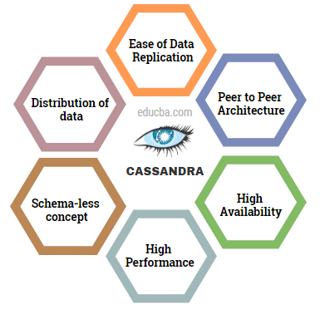
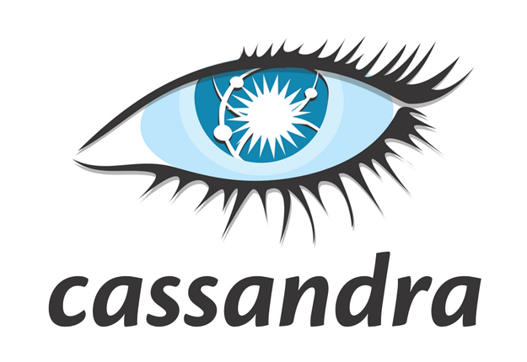
Introduction to Cassandra
The Apache Cassandra data storage system differs greatly from a relational database management system in many ways. In January 2009, Apache Cassandra was first incubated as a project.
Apache Cassandra is an open source, distributed, decentralized, elastically scalable, highly available, fault-tolerant, tuneably consistent, column-oriented database that bases its distribution design on Amazon’s Dynamo and its data model on Google’s Bigtable.
Created at Facebook and it is now used at some of the most popular sites on the Web.
In addition to performing blazingly fast writes, it can store hundreds of terabytes of data, and it is decentralized and symmetrical, so the failure point is eliminated. It provides schema-free data models and is highly available.
Cassandra's interface allows it to be accessed from a variety of languages, including C#, Scala, Python, and Ruby.
Notes:
Also called Alexandra. Classical Mythology. a daughter of Priam and Hecuba, a prophet cursed by Apollo so that her prophecies, though true, were fated never to be believed.
a person who prophesies doom or disaster.
a female given name: from a Greek word meaning “helper of men.”

Slide 4
What is Cassandra?
Cassandra is a fully distributed, masterless database, offering superior scalability, and fault tolerance as compared to traditional single-master databases.
Many of the world's leading technology firms, such as Apple, Netflix, and Instagram, are using Cassandra and are open-sourcing, including new features.
It is being actively developed and has one of largest open-source communities with close to 200 contributors and over 20,000 commits.
Some of the companies that use Cassandra in their production clusters
IBM, Adobe, HP, eBay, Ericsson, Symantec
Twitter, Spotify
PBS Kids
Netflix: uses Cassandra to keep track of your current position in the video you’re watching.
https://www.jcount.com/7-reasons-netflix-uses-cassandra-databases/
Notes:
Compared with other popular distributed databases such as Riak, HBase, and Voldemort, Cassandra offers a uniquely robust and expressive interface for modeling and querying data.

Slide 5
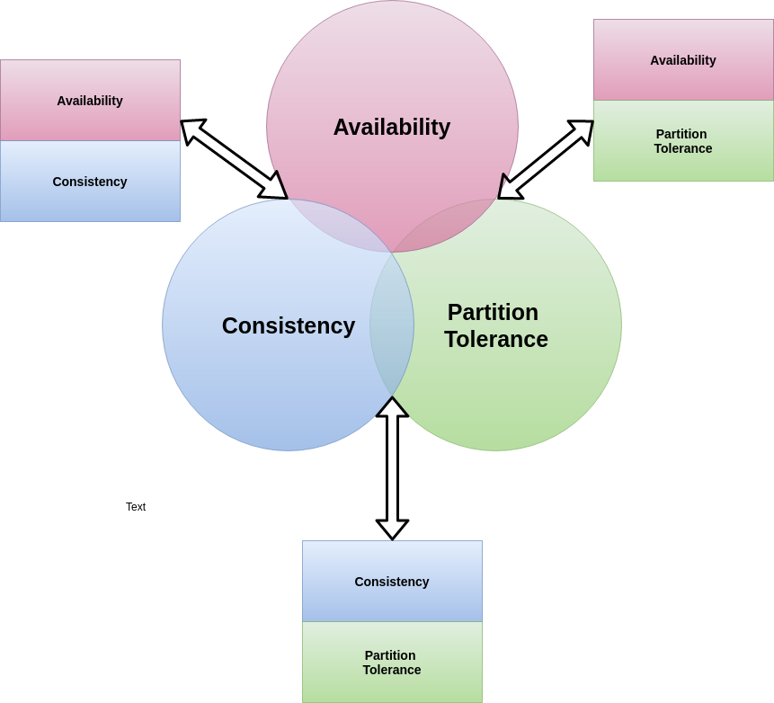
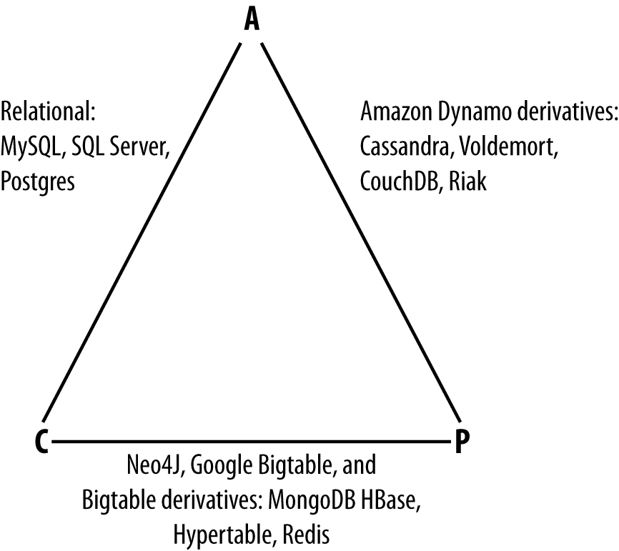
CAP Theorem Revision
Consistency: All database clients will read the same value for the same query, even given concurrent updates.
Availability: All database clients will always be able to read and write data.
Partition tolerance: The database can be split into multiple machines; it can continue functioning in the face of network segmentation breaks.
CA:
To support consistency and availability means that you are likely using two-phase commit for distributed transactions.
It means that the system will block when a network partition occurs, so it may be that your system is limited to a single data center cluster in an attempt to mitigate this.
CP:
To support consistency and partition tolerance, you may try to advance your architecture by setting up data shards in order to scale.
Your data will be consistent, but you still run the risk of some data becoming unavailable if nodes fail.
AP:
To support availability and partition tolerance, your system may return inaccurate data, but the system will always be available, even in the face of network partitioning.
DNS is the most popular example of a system that is massively scalable, highly available, and partition tolerant.
CAP theorem indicates that you can realize only two of these properties at once
Different databases appear on the CAP continuum

Slide 6
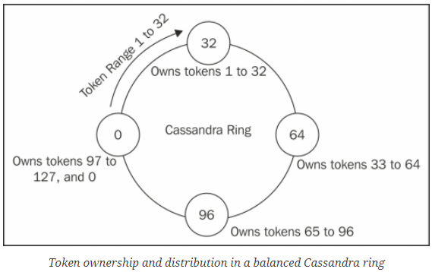
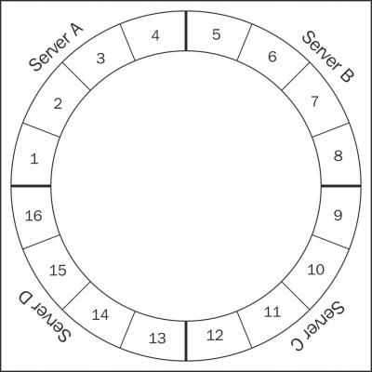
Characteristics of Cassandra Distributed and Decentralized
Cassandra is distributed, which means that it is capable of running on multiple machines while appearing to users as a unified whole.
For optimizing performance across multiple data center racks, and for a single Cassandra cluster running across geographically dispersed data centers, we can confidently write data to anywhere in the cluster and Cassandra can get it.
Once we start to scale many other data stores, such as MySQL, Bigtable, some nodes need to be set up as masters in order to organize other nodes, which are set up as slaves.
The feature of decentralization basically means there is no master-slave paradigm or identical nodes. Cassandra has each and every separate node that has the capacity to present itself to an end-user as a replica, complete or partial, of the database.
The fact that Cassandra is decentralized means that there is no single point of failure.
Server Symmetry means that all nodes in a Cassandra cluster function exactly in a similar way.
Notes:
The process of decentralization means that there will be no network congestion or bottlenecks, and every node in the cluster is identical.

Slide 7
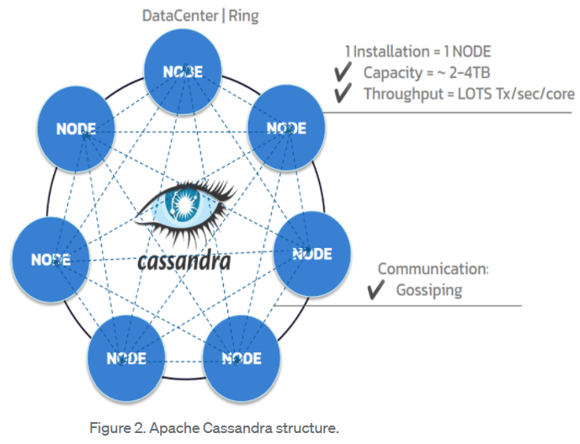
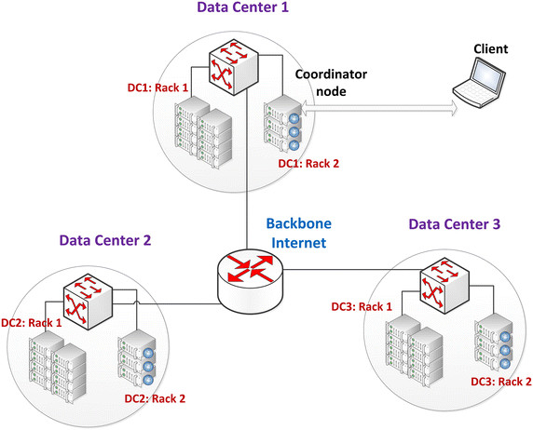
Characteristics of Cassandra Distributed and Decentralized
Cassandra's high availability is largely due to its decentralized design.
In the world of RDBMS, master/slave replication is easy to grasp.
The two main benefits of decentralization are that it is easier to use than master/slave and that it helps you to prevent outages.
This means that scaling is simple and that setting up 50 nodes is not all that different from setting up one.
In a master/slave setup, the master can become a single point of failure (SPOF) which can be avoided by considering multiple masters in the Cassandra environment.
Cassandra is distributed and decentralized, there is no single point of failure, which allows high availability.
All of the replicas in Cassandra are identical, therefore failures of a node won't affect service.
Notes:
https://medium.com/building-the-open-data-stack/introduction-to-apache-cassandra-the-lamborghini-of-the-nosql-world-5028b7e4f4b2

Slide 8
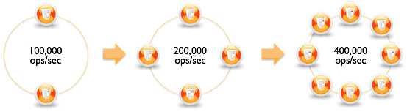
Characteristics of Cassandra Elastic Scalability
Scalability is an architectural feature of a system that can continue serving a greater number of requests with little degradation in performance. Apache Cassandra is highly scalable software.
Elastic scalability refers to a special property of horizontal scalability. It means that your cluster can scale up and scale back down.
https://docs.datastax.com/en/cassandra-oss/3.x/cassandra/cassandraAbout.html
When you scale down, your cluster's processing power is reduced. For business purposes, you might do this to accommodate seasonal demands in the travel or retail industries.
It allows an organization to expand its hardware to accommodate an industry's growing data demands.
With Cassandra, capacity may be readily increased by simply bringing new nodes online. This is known as linear scalability.
Notes:
Vertical scaling—simply adding more hardware capacity and memory to your existing machine—is the easiest way to achieve this. Horizontal scaling means adding more machines that have all or some of the data on them so that no one machine has to bear the entire burden of serving requests. But then the software itself must have an internal mechanism for keeping its data in sync with the other nodes in the cluster.
https://docs.datastax.com/en/cassandra-oss/3.x/cassandra/cassandraAbout.html
Large corporations like Netflix, Uber, and Apple employ this software because it enables them to modify the scales to meet their needs without sacrificing the effectiveness of the operations.
To do this, the cluster must be able to accept new nodes that can begin participating by getting a copy of some or all of the data and start serving new user requests without major disruption or reconfiguration of the entire cluster.
As seen in the example below, if two nodes can process 100,000 transactions per second, four nodes can process 200,000 transactions per second, and eight nodes can process 400,000 transactions per second.

Slide 9
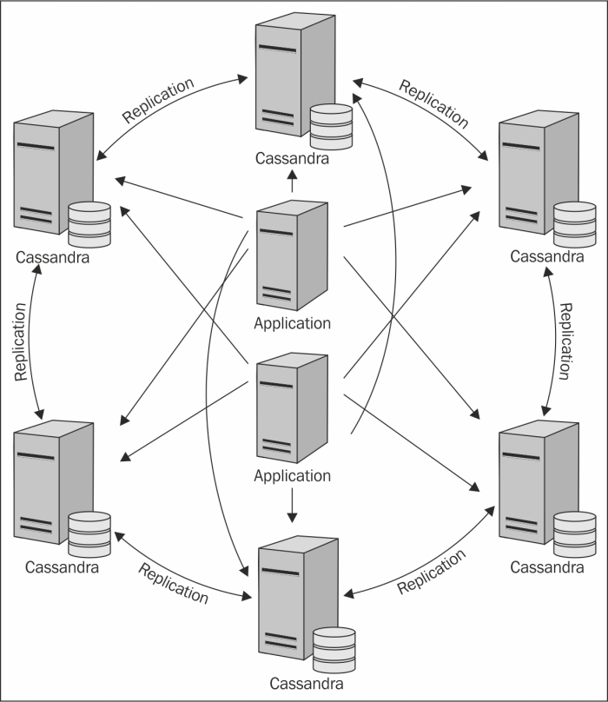
Characteristics of Cassandra High Availability and Fault Tolerance
A system's availability is determined by its capacity to handle requests including to handle different types of computer failures, including corrupting software, network outages, and hardware component failures.
Cassandra is really accessible. Without any downtime, you may replace broken nodes in the cluster.
We can replicate data across different data centres to increase local performance and guard against downtime in the event that a single data center is damaged by a disaster like a fire or flood.
One of Cassandra's finest advantages is the automatic replication of the data across several nodes. Cassandra fault tolerance activates the product's ability to duplicate. Furthermore, because they quickly replace the lost nodes, many data centres support replication.
Notes:
https://subscription.packtpub.com/book/big_data_and_business_intelligence/9781783989126/1/ch01lvl1sec12/cassandra-s-architecture
But anyone can accidentally break an Ethernet cable, and catastrophic events can beset a single data center. So for a system to be highly available, it must typically include multiple networked computers, and the software they’re running must be capable of operating in a cluster and have some facility for recognizing node failures and failing over requests to another part of the system.

Slide 10
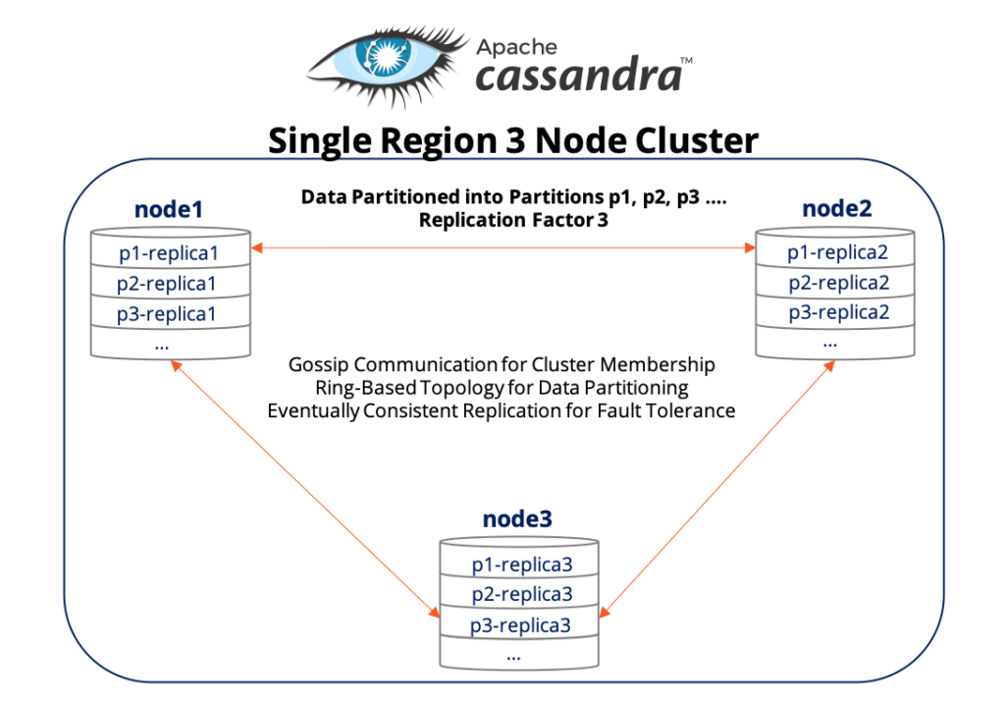
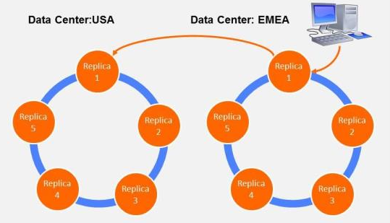
Characteristics of Cassandra Tuneable Consistency
Consistency means that a read always returns most recently written value.
Imagine that on an e-commerce site, two users are attempting to add the same last item to their shopping baskets. The last item in stock should be added to your cart and the other customer should be informed immediately of no longer availability of the item.
This is guaranteed to happen when the state of a write is consistent among all nodes that have that data.
Scaling data stores means making certain trade-offs between data consistency, node availability, and partition tolerance.
Cassandra is termed as “tuneably consistent,” which means it allows you to easily decide the level of consistency you require, in balance with the level of availability.

Slide 11
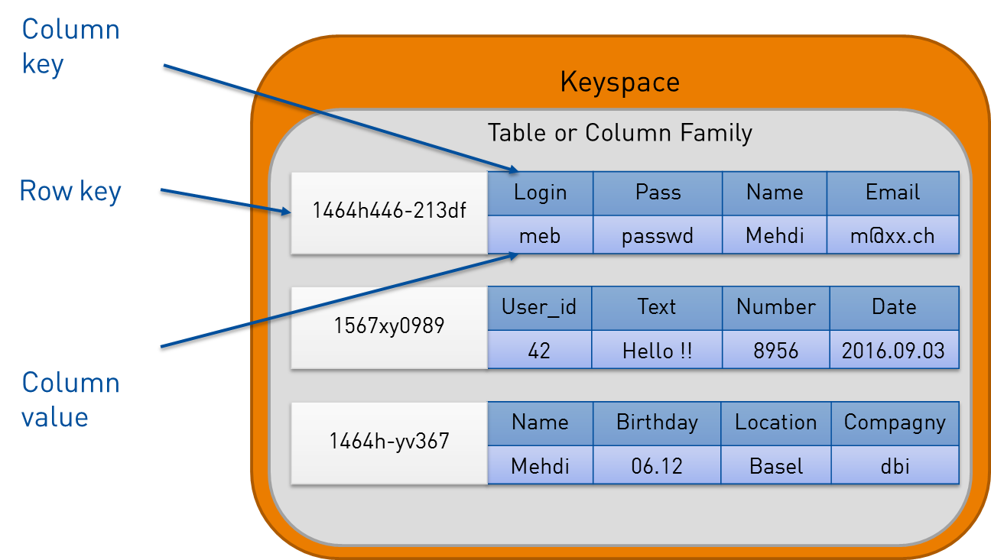
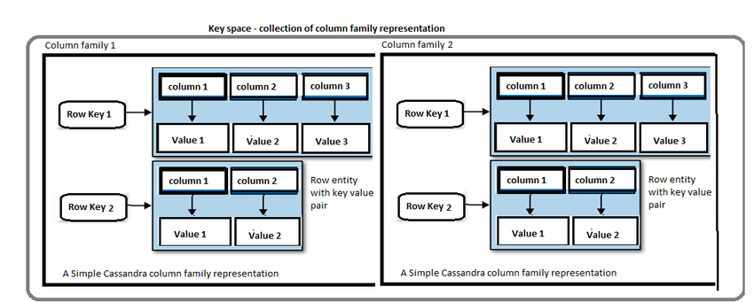
Characteristics of Cassandra Row-Oriented
Cassandra’s data model can be described as a partitioned row store, in which data is stored in sparse multidimensional hashtables.
“Sparse” means that for any given row you can have one or more columns, but each row doesn’t need to have all the same columns as other rows like it (as in a relational model).
“Partitioned” means that each row has a unique key which makes its data accessible, and the keys are used to distribute the rows across multiple data stores.
A column-oriented database is one in which the data is stored by columns, as opposed to relational databases, which store data in rows.
Notes:
In the relational storage model, all of the columns for a table are defined beforehand and space is allocated for each column whether it is populated or not. In contrast, Cassandra stores data in a multidimensional, sorted hash table. As data is stored in each column, it is stored as a separate entry in the hash table. Column values are stored according to a consistent sort order, omitting columns that are not populated, which enables more efficient storage and query processing.

Slide 12
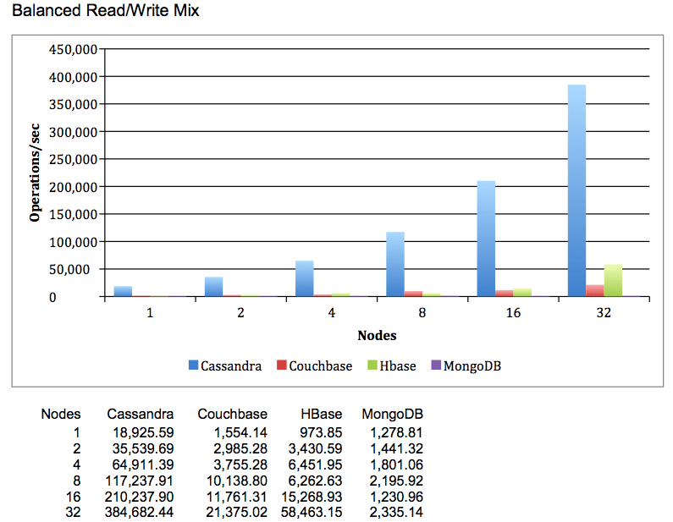
Characteristics of Cassandra High Performance
Cassandra was designed from the ground up to take full advantage of multiprocessor/ multi-core machines, and to run across many dozens of these machines housed in multiple data centres.
Cassandra scales smoothly and consistently to many terabytes.
Cassandra has been shown to perform exceptionally well under heavy load.
It consistently can show very fast throughput for writes per second on basic commodity computers, whether physical hardware or virtual machines.
You can preserve all of Cassandra's advantageous characteristics without compromising performance as you can add more servers.
https://www.isaacbigdata.com/performance-cassandra/
Notes:
HOW DID CASSANDRA GET ITS NAME?
In Greek mythology, Cassandra was the daughter of King Priam and Queen Hecuba of Troy. Cassandra was so beautiful that the god Apollo gave her the ability to see the future. But when she refused his amorous advances, he cursed her such that she would still be able to accurately predict everything that would happen—but no one would believe her. Cassandra foresaw the destruction of her city of Troy, but was powerless to stop it. The Cassandra distributed database is named for her. We speculate that it is also named as kind of a joke on the Oracle at Delphi, another seer for whom a database is named.

Slide 13
IS CASSANDRA “SCHEMA-FREE”?
In its early versions, Cassandra was faithful to the original Bigtable whitepaper in supporting a “schema-free” data model in which new columns can be defined dynamically.
The major drawback of schema-free databases is the difficulty in determining the meaning and format of data, which limits the ability to perform complex queries.
Due to these drawbacks, many startups found it difficult to adopt the system, especially when they grew into larger enterprises involving multiple developers and administrators.
The solution for those users was the introduction of the Cassandra Query Language (CQL), which provides a way to define schema via a syntax similar to the Structured Query Language (SQL).
Initially, CQL was provided as another interface to Cassandra alongside the schema-free interface based on the Apache Thrift project. During this transitional phase, the term “Schema-optional” was used to describe that data models could be defined by schema using CQL.
Notes:
A remote procedure call (RPC) framework known as Apache Thrift was initially created at Facebook and later made available as an Apache Software Foundation project. Its main objective is to make it easier for various systems and services to communicate effectively and across languages.

Slide 14
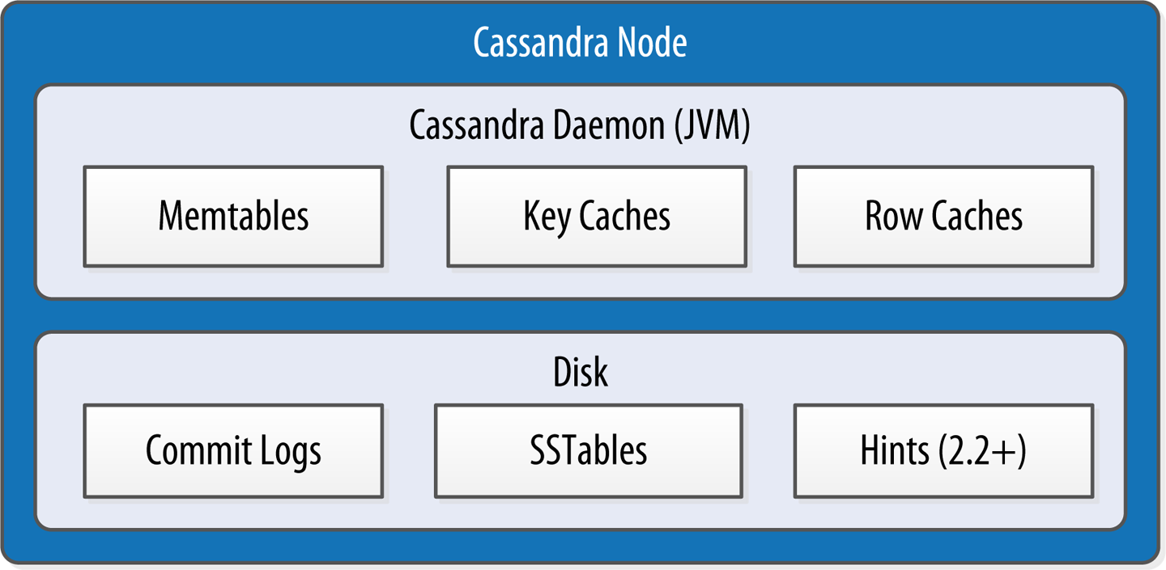
Components of Cassandra
Node: A Cassandra node is a place where data is stored.
Data center: Data center is a collection of related nodes.
Cluster: A cluster is a component which contains one or more data centres.
Commit log: In Cassandra, the commit log is a crash-recovery mechanism. Every write operation is written to the commit log.
Mem-table: A mem-table is a memory-resident data structure. After commit log, the data will be written to the mem-table. Sometimes, for a single-column family, there will be multiple mem-tables.
SSTable: It is a disk file to which the data is flushed from the mem-table when its contents reach a threshold value.
Internal data structures and files of a Cassandra node
Cassandra stores data both in memory and on disk to provide both high performance and durability.
We focus on Cassandra’s storage engine and its use of constructs called memtables, SSTables, and commit logs to support the writing and reading of data from tables.
Notes:
When a node receives a write operation , it immediately writes the data to a commit log. The commit log is a crash-recovery mechanism that supports Cassandra’s durability goals. A write will not count as successful on the node until it’s written to the commit log, to ensure that if a write operation does not make it to the in-memory store (the memtable, discussed in a moment), it will still be possible to recover the data. If you shut down the node or it crashes unexpectedly, the commit log can ensure that data is not lost. That’s because the next time you start the node, the commit log gets replayed. In fact, that’s the only time the commit log is read; clients never read from it.
Bloom filter: These are nothing but quick, nondeterministic, algorithms for testing whether an element is a member of a set. It is a special kind of cache. Bloom filters are accessed after every query.
Sorted Strings Table (SSTable) is a persistent file format used by ScyllaDB, Apache Cassandra, and other NoSQL databases to take the in-memory data stored in memtables, order it for fast access, and store it on disk in a persistent, ordered, immutable set of files. [https://www.scylladb.com/]

Slide 15
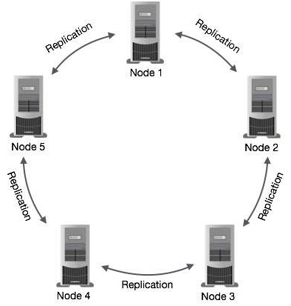
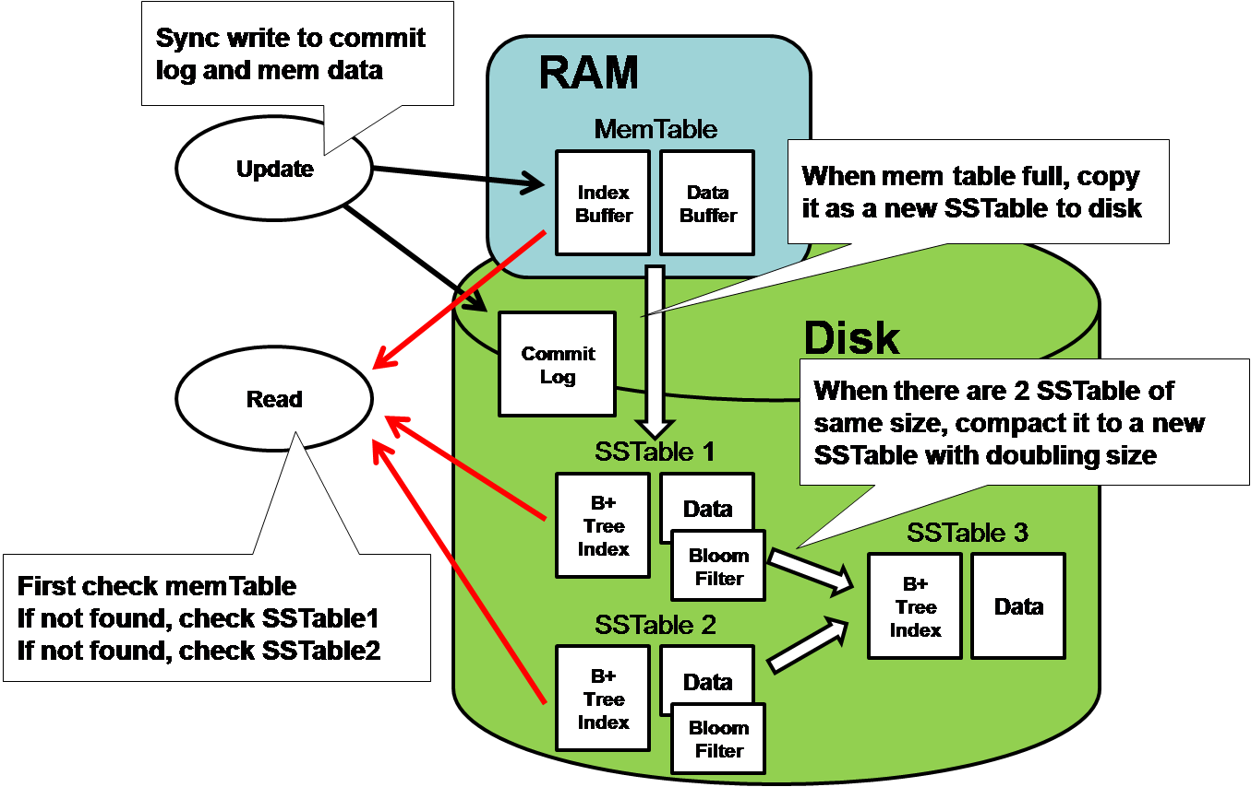
Cassandra Architecture
Cassandra was designed to handle big data workloads across multiple nodes without a single point of failure.
It has a peer-to-peer distributed system across its nodes, and the data is distributed among all the nodes in a cluster.
In Cassandra, each node is independent and at the same time interconnected to other nodes. All the nodes in a cluster play the same role.
Every node in a cluster can accept read and write requests, regardless of where the data is located in the cluster.
In the case of failure of one node, Read/ Write requests can be served from other nodes in the network.

Slide 16
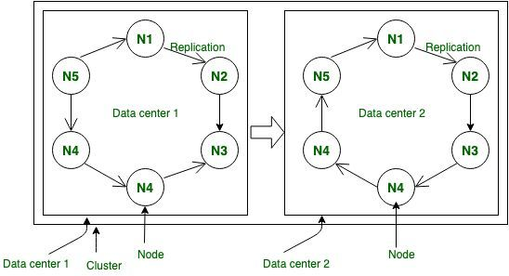
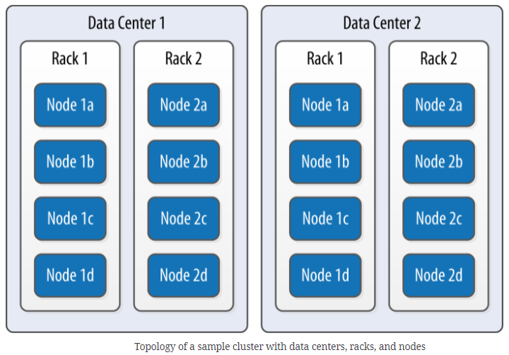
Data Replication in Cassandra
Nodes in a Cassandra cluster serve as replicas for a certain piece of data.
Cassandra will give the client the most recent value if some of the nodes respond with an out-of-date value.
Cassandra updates the outdated values in the background after returning the most recent value.
The illustrations make it obvious how Cassandra uses data replication among cluster nodes to prevent a single point of failure.

Slide 17
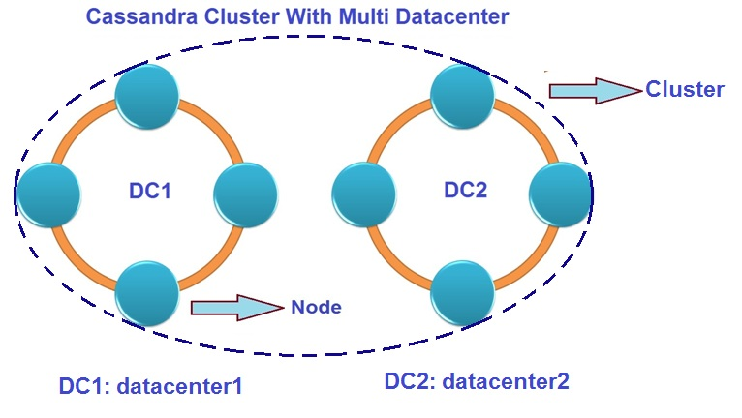
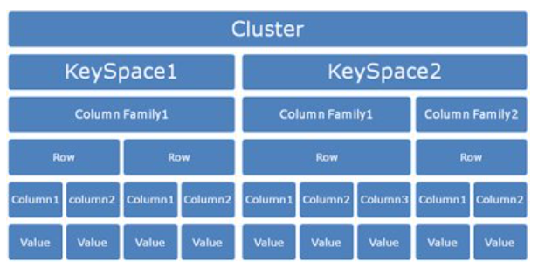
Cassandra Data Model
Cluster: Cassandra database is distributed over several machines that are operated together. Cassandra arranges the nodes in a cluster, in a ring format, and assigns data to them.
Keyspace: Keyspace is the outermost container for data in Cassandra.
Column families: Column families are placed under keyspace. A keyspace is a container for a list of one or more column families while a column family is a container of a collection of rows. Each row contains ordered columns. Column families represent the structure of your data.
Replication factor: It specifies the number of machines in the cluster that will receive copies of the same data.
Notes:
Following are the basic attributes of Keyspace in Cassandra
Replication factor: It specifies the number of machine in the cluster that will receive copies of the same data.
Replica placement Strategy: It is a strategy which species how to place replicas in the ring. There are three types of strategies such as:
Simple strategy (rack-aware strategy)
old network topology strategy (rack-aware strategy)
network topology strategy (datacenter-shared strategy)

Slide 18
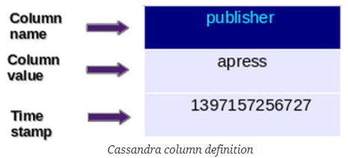
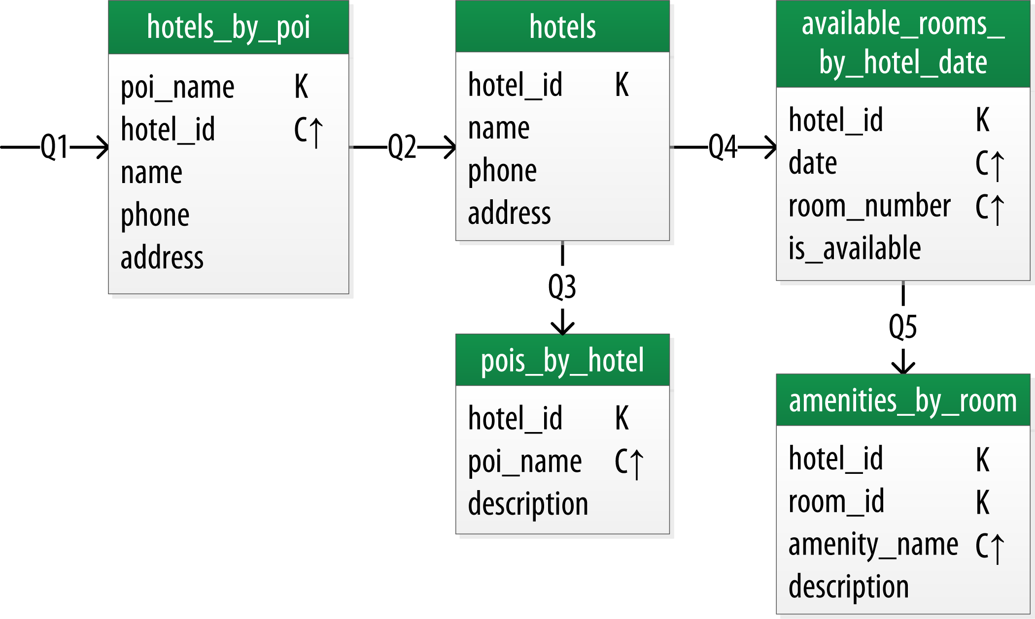
Cassandra Data Models Rules
Cassandra doesn't support JOINS, GROUP BY, OR clause, aggregation etc. You have to make sure the data is stored in a way that it can be accessed at any time.
Cassandra is optimized for high write performances so you should maximize your writes for better read performance and data availability. There is a trade-off between data write and data read. So, optimize your data read performance by maximizing the number of data writes.
Maximize data duplication because Cassandra is a distributed database and data duplication provides instant availability without a single point of failure.
Q1. Find hotels near a given point of interest.
Q2. Find information about a given hotel, such as its name and location.
Q3. Find points of interest near a given hotel.
Q4. Find an available room in a given date range.
Q5. Find the rate and amenities for a room.

Slide 19
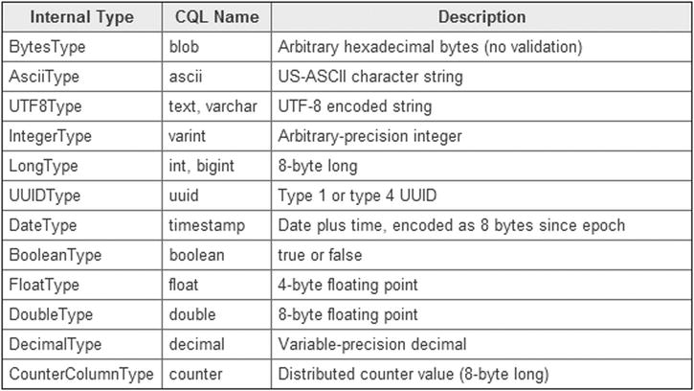
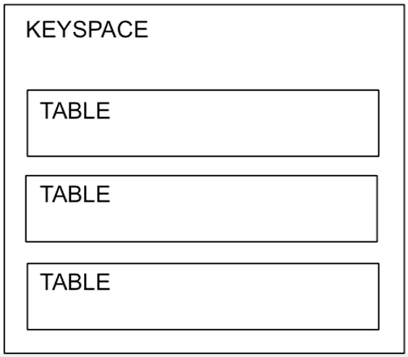
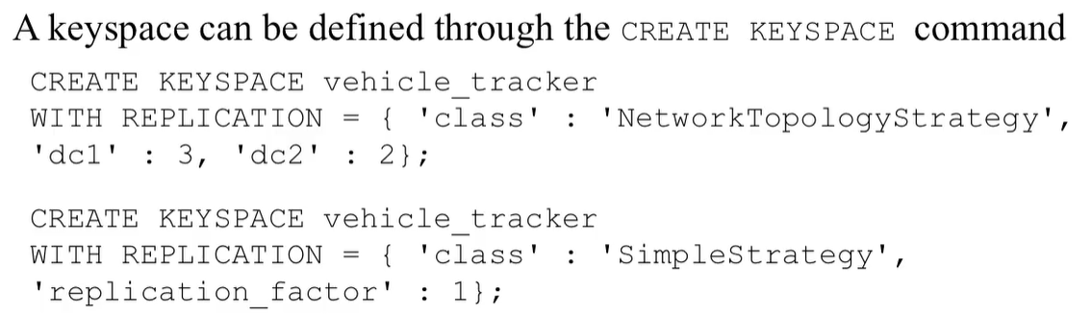
Cassandra CQLSH
Cassandra CQLSH stands for Cassandra CQL shell.
CQLSH specifies how to use Cassandra commands.
After installation, Cassandra provides a prompt Cassandra query language shell (cqlsh). It facilitates users to communicate with it.
Cassandra commands are executed on CQLSH. It looks like this:

Slide 20
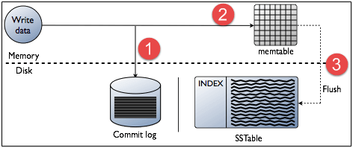
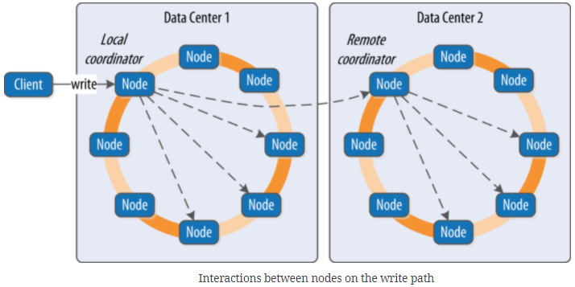
Cassandra Write Operations
Every write activity of nodes is captured by the commit logs written in the nodes.
Later the data will be captured and stored in the mem-table.
Whenever the mem-table is full, the data will be written into the SStable data file.
All writes are automatically partitioned and replicated throughout the cluster.
Cassandra periodically consolidates the SSTables, discarding unnecessary data.
Notes:
Sorted Strings Table (SSTable) is a persistent file format used by ScyllaDB, Apache Cassandra, and other NoSQL databases to take the in-memory data stored in memtables, order it for fast access, and store it on disk in a persistent, ordered, immutable set of files.

Slide 21
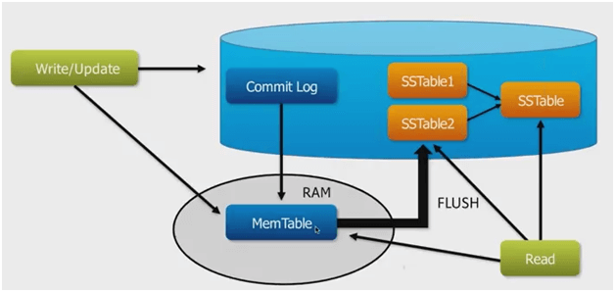
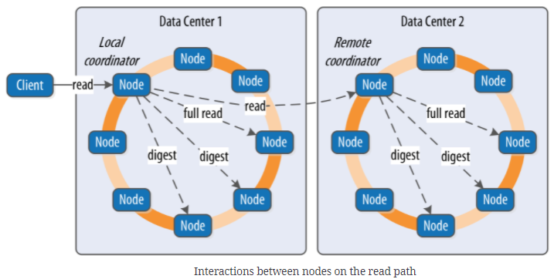
Cassandra Read Operations
In Read operations, Cassandra gets values from the mem-table and checks the bloom filter to find the appropriate SSTable which contains the required data. There are three types of read request that is sent to replicas by coordinators.
Direct request
Digest request
Read repair request
The coordinator sends direct request to one of the replicas. After that, the coordinator sends the digest request to the number of replicas specified by the consistency level and checks if the returned data is an updated data.
The coordinator then issues digest requests to all of the surviving copies. A background read repair request will update the data if any node provides an out-of-date value. This process is called read repair mechanism.

Slide 22
Resources/ References
Cassandra: The Definitive Guide, 2nd Edition, Jeff Carpenter, Eben Hewitt, O'Reilly Media, Inc., July 2016.
Learning Apache Cassandra - Second Edition, Sandeep Yarabarla, Packt Publishing, April 2017.
Data modeling with Cassandra, Jeff Carpenter, Eben Hewitt, O'Reilly Media, Inc., December 2016.
https://www.javatpoint.com/cassandra-create-table
Some images are used from Google search repository (https://www.google.ie/search) to enhance the level of learning.
Copyright Notice The following material has been communicated to you by or on behalf of CCT College Dublin in accordance with the Copyright and Related Rights Act 2000 (the Act). The material may be subject to copyright under the Act and any further reproduction, communication or distribution of this material must be in accordance with the Act. Do not remove this notice

